Slide 1
Predicting the right location to Start a restaurant in New York City

Slide 2
Doing analysis of business is essential for its success
There are many factors that influence the success of a business which includes
> Location of Business
> Other similar business in the location
> Availability of raw materials in the area
> Other facilities in the area
The program focuss on collecting data from different platforms and then using it to analyse the right location to start the business

Slide 3
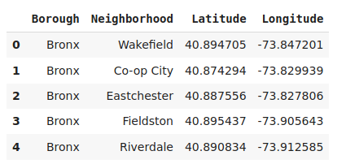
Data Acquisition
Dataset 1:
The dataset which contains a total of 5 boroughs and 306 neighbourhoods in New York City.
The dataset also contains the latitude and longitude cordinates of each neighbourhood.
Link to Dataset : https://geo.nyu.edu/catalog/nyu_2451_34572

Slide 4
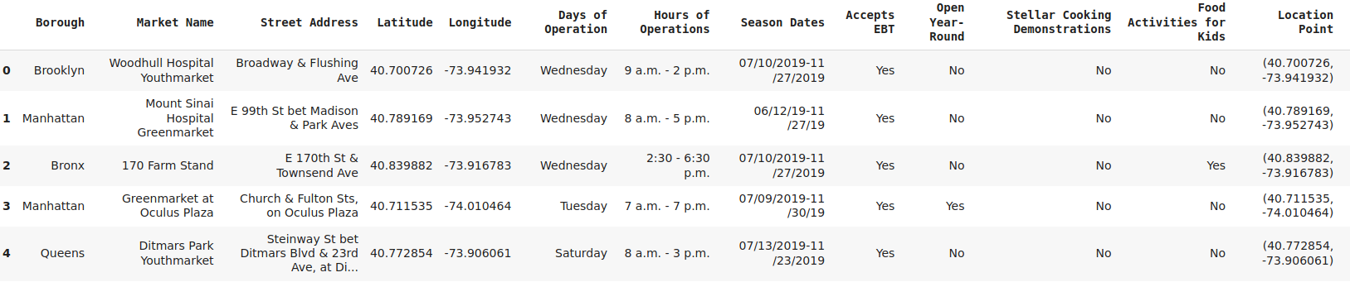
Data Acquisition
Dataset 2:
The dataset contains the list of Farmer Markets in NYC. The dataset is a part of the website GrowNYC.
The data is available as excel file in the link below
https://data.cityofnewyork.us/dataset/DOHMH-Farmers-Markets-and-Food-Boxes/8vwk-6iz2

Slide 5
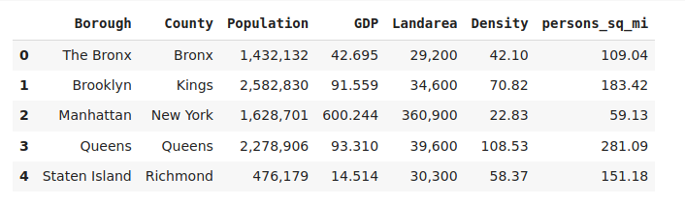
Data Acquisition
Dataset 3:
Economy of New York City. The data was scrapped from the wikipedia page.
https://en.wikipedia.org/wiki/Economy_of_New_York_City

Slide 6
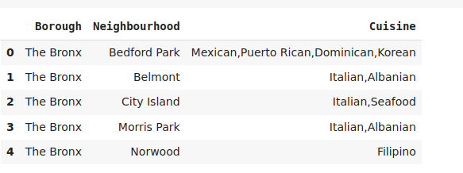
Data Acquisition
Dataset 4:
Cusines in New York. The data was available in text format. It was manually collected and converted to excel format.
https://en.wikipedia.org/wiki/Cuisine_of_New_York_City

Slide 7
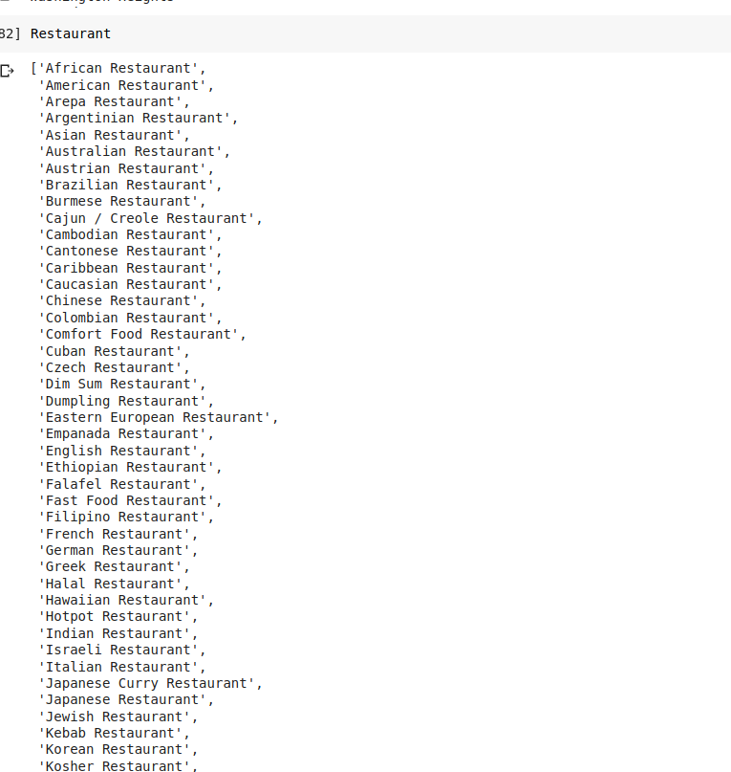
Data Acquisition
Dataset 5:
List of restaurants . It is obtained by using the FourSquare API.

Slide 8
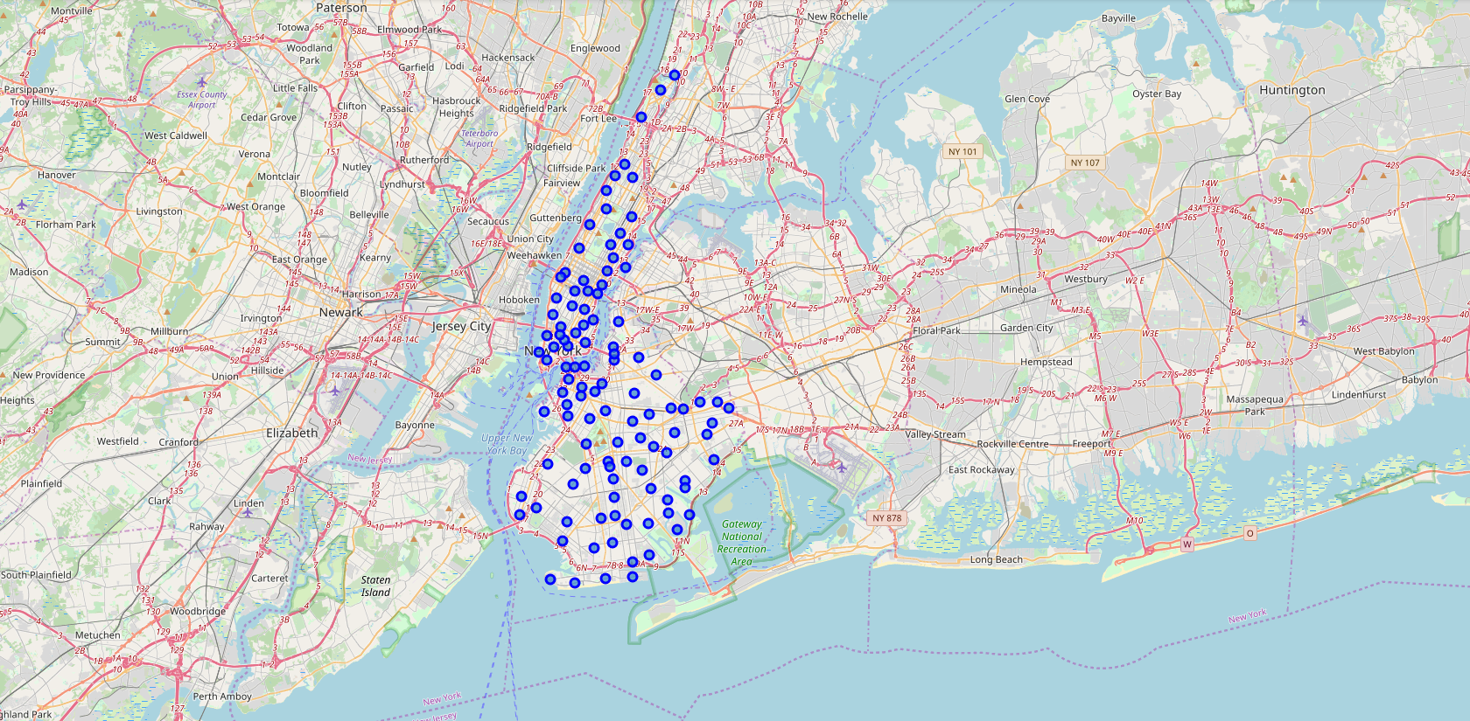
Data Analysis
Visualizing the data in Brooklyn and Manhattan

Slide 9
Data Analysis
The data from different stations is collected by using Foursquare API, and then the list of restaurants are colected by using some cleansing process.

Slide 10

Data Analysis
After collecting data from all the sources we use Kmeans clustering to create clusters.
The number of clusters which are needed are found by calculating the Silhoutte Coefficient and we have found that for 2 clusters we have the highest values of Silhoutte Coefficient.
The Clusters are then analysed to see if there are any Untapped Markets in the neighbourhood.

Slide 11
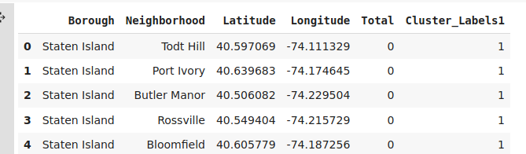
Data Analysis
Now the same process is done on other 3 neighborhoods. And we have the results as below

Slide 12
Conclusion
Based on the analysis, there is scope to increase the Farmers Markets and also possibility to start restaurants of various cuisines in Bronx, Queens and Staten Island.

Slide 13
This work is licensed under a Creative Commons Attribution-ShareAlike 3.0 Unported License. It makes use of the works of Mateus Machado Luna.

